Slide 1
Week 3 Report
Qi Luo, Sidharth Suravarapu
OSHKOSH PROJECT: Assessment of Autonomous Driving Software Performance on Edge Devices

Slide 2
Primary Objectives
1
Implement Autoware on Ambarella edge device
2
Evaluate the capability of the Ambarella devices
3
Compare the performance of Ambarella device to the NVIDIA ORIN

Slide 3
Completed Tasks
Resolved GPU/Docker issues
Performance Matrix element collection
Review Ambarella documentations
Preliminary testing on Ambarella Box
Ambarella Box:
Fedora: Autoware is built for Ubuntu 20.04/22.04
ARM64
Ambarella Softwares (Perception/Computation)
Notes:
Can we run Autoware on Ambrella native system directly?
How do the stack compare to Nvidia Jetson.

Slide 4
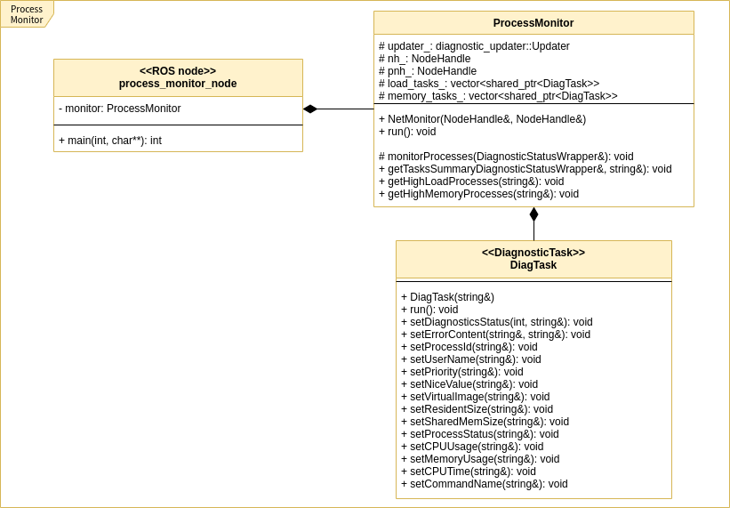
Candidates for Hardware Monitoring
System Monitor
Publishes topics for various hardware parameters:
CPU Monitor
HDD Monitor
Memory Monitor
Network Monitor
NTP Monitor
Process Monitor
GPU Monitor
Voltage Monitor
Example: Class Diagram for Process Monitor
https://autowarefoundation.github.io/autoware.universe/latest/system/system_monitor/

Slide 5
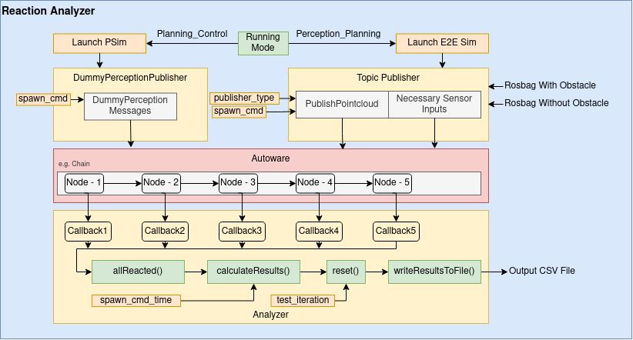
Candidates for Software Monitoring
Reaction Analyzer
Subscribes to predetermined topics
Reports Node Latency, Pipeline Latency, and Total Latency for each of the nodes
https://github.com/autowarefoundation/autoware.universe/tree/main/tools/reaction_analyzer

Slide 6
Other Ongoing Tasks
Create a shell/python script recording OS level resource usage
Learn and Explore the Ambarella SDK
Discuss alternative solutions
Explore the Red Hat Fedora solution

Slide 7
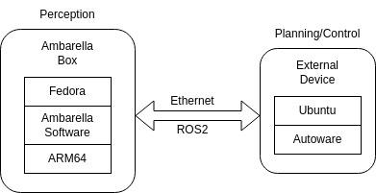
Proposal: Secondary Device

Slide 8
Issues
Source vs. Docker
Fedora vs. Ubuntu (Ambarella Driver SDK)
Single Device vs. Secondary Device

